Slide 1

CS 214 Object Oriented Programming
Department of Computer Science and Engineering

Slide 2
CS 214 Object Oriented Programming
Teaching Scheme Credits: 02 + 01
Theory: 3 Hrs / Week Practical: 2Hrs/Week
Course Objectives:
To understand the concepts of Object Oriented Programming.
To design and implement applications using various OOP features
To build foundation for advanced programming
Course Outcomes:
Analyze the fundamentals of Object Oriented Programming.
Ability to develop applications using Object Oriented Programming Concepts.
Ability to implement features of object oriented programming to solve real world problems.

Slide 3
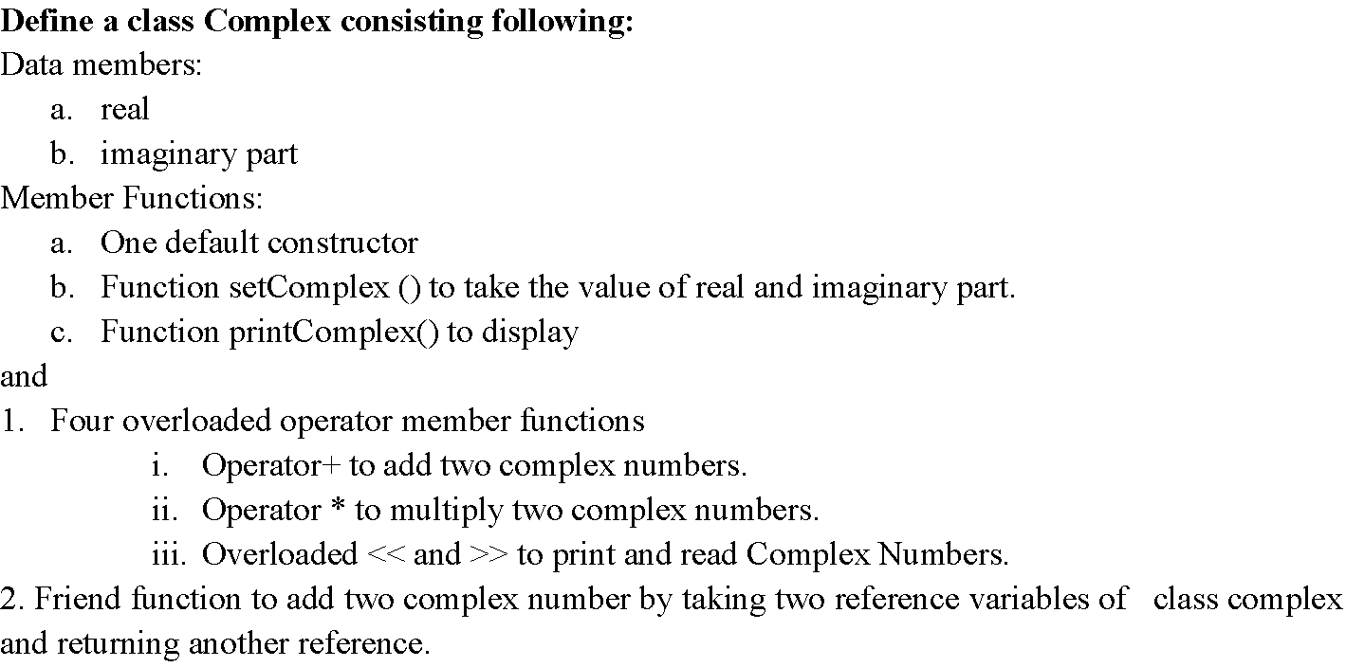
Laboratory Assignment No: 01

Slide 4



Class Diagram
Complex
Class
Properties
real
imag
Methods
complex
setComplex
printComplex
getReal
getImag
GetIMEICode

Slide 5
Syntax of Class
keyword
class class_name
{
private:
variable declaration;
public:
function declaration;
….
} ;
data member
body
member
function
access
specifiers
Notes:
Classes are generally declared using the keyword class, with the following statement
The body of the declaration can contain members that can be either data or function declaration, and optionally access specifier.
The variable declared inside the class is known as data member and the function are known as member functions
Access specifiers are keywords in object oriented language that set the accessibility of classes, method and other member.

Slide 6
Syntax of Class
keyword
class class_name
{
private:
variable declaration;
public:
function declaration;
….
} ;
data member
body
member
function
access
specifiers
Notes:
Classes are generally declared using the keyword class, with the following statement
The body of the declaration can contain members that can be either data or function declaration, and optionally access specifier.
The variable declared inside the class is known as data member and the function are known as member functions
Access specifiers are keywords in object oriented language that set the accessibility of classes, method and other member.

Slide 7
Example of Student Class
/*C++ program to create class for a student.*/
#include <iostream>
using namespace std;
class student
{
private:
char name[30];
int rollNo;
int total;
float perc;
public:
//member function to get student's details
void getDetails(void);
//member function to print student's details
void putDetails(void);
};
//member function definition, outside of the class
void student::getDetails(void){
cout << "Enter name: " ;
cin >> name;
cout << "Enter roll number: ";
cin >> rollNo;
cout << "Enter total marks outof 500: ";
cin >> total;
perc=(float)total/500*100;
}
//member function definition, outside of the class
void student::putDetails(void){
cout << "Student details:\n";
cout << "Name:"<< name << ",Roll Number:" << rollNo << ",Total:" << total << ",Percentage:" << perc;
}
int main()
{
student std; //object creation
std.getDetails();
std.putDetails();
return 0;
}

Slide 8
Algorithm
Create a class Complex.
Add data members as real and imaginary in private section
Add default and parameterized constructor
Add member functions like
setComplex(int,int) for setting new values of real and imag
printComplex() to print values of real and imag
overloaded operator + and * to add and multiply two complex numbers
Overlaoded << and >> to print and read Complex Numbers
Friend function to add two complex number
Create main method to create menu driven interface for performing arithmatic operations of complex object.

Slide 9
Extensions to Program
Add constructor with default argument
Add parameterized constructor
Add copy constructor
Add getter and setter for each property
Add operator function for -,/
Add friend function for opertaor -,*,/

Slide 10
Practice Assignments
Design and Implement Class ‘String’ with a default, parameterized and copy Constructors. Provide member functions to accept and display string and friend function to concatenate and compare two strings without using operator overloading.
Design a class “Distance” with kilometers, meters, centimeters as data items. Provide parameterized and copy constructor and overload ‘+’, ‘-’, ‘*’, ‘<>’ operators.
Design a class “Time” with Hours, minutes and seconds as data members. Provide parameterized and copy constructor and overload ‘+’, ‘-‘, ‘<>’ operators.

Slide 11
Thank You!

